Slide 1

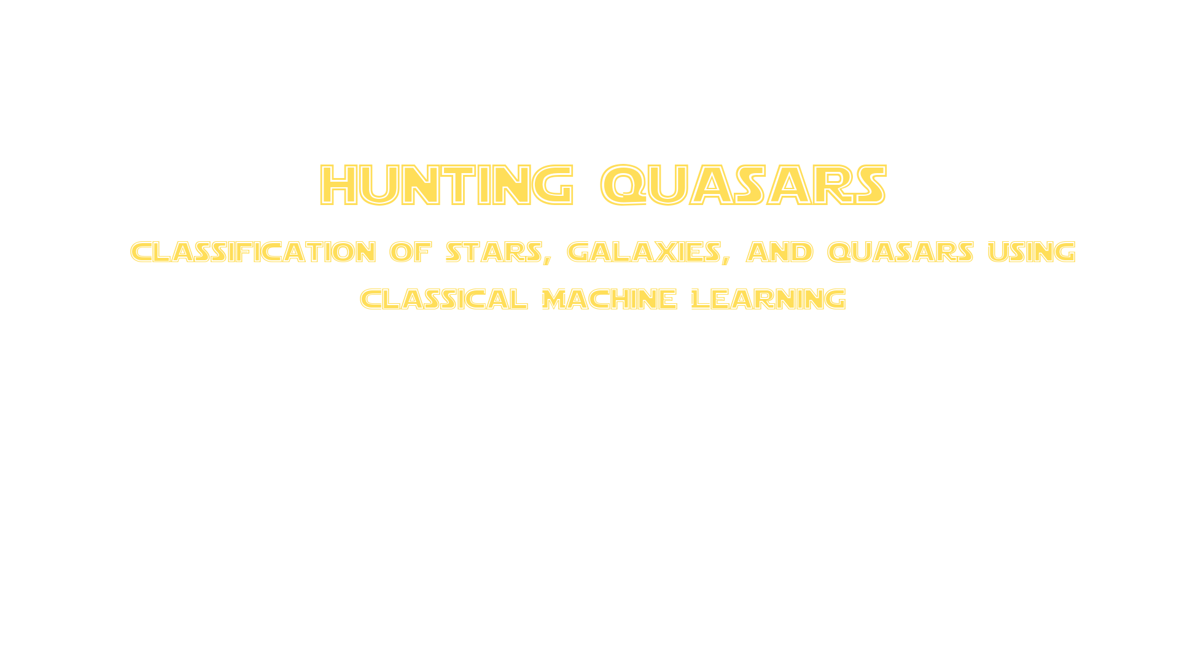
Team members
Rawan Elwany 2402133
Sama hany 2401610
Yousra Mohamed 2401637
Aya Shabaan 2401918
Rawan wael 2400586
Jana Hany 2401929
Malak Shady 2402135

Slide 2

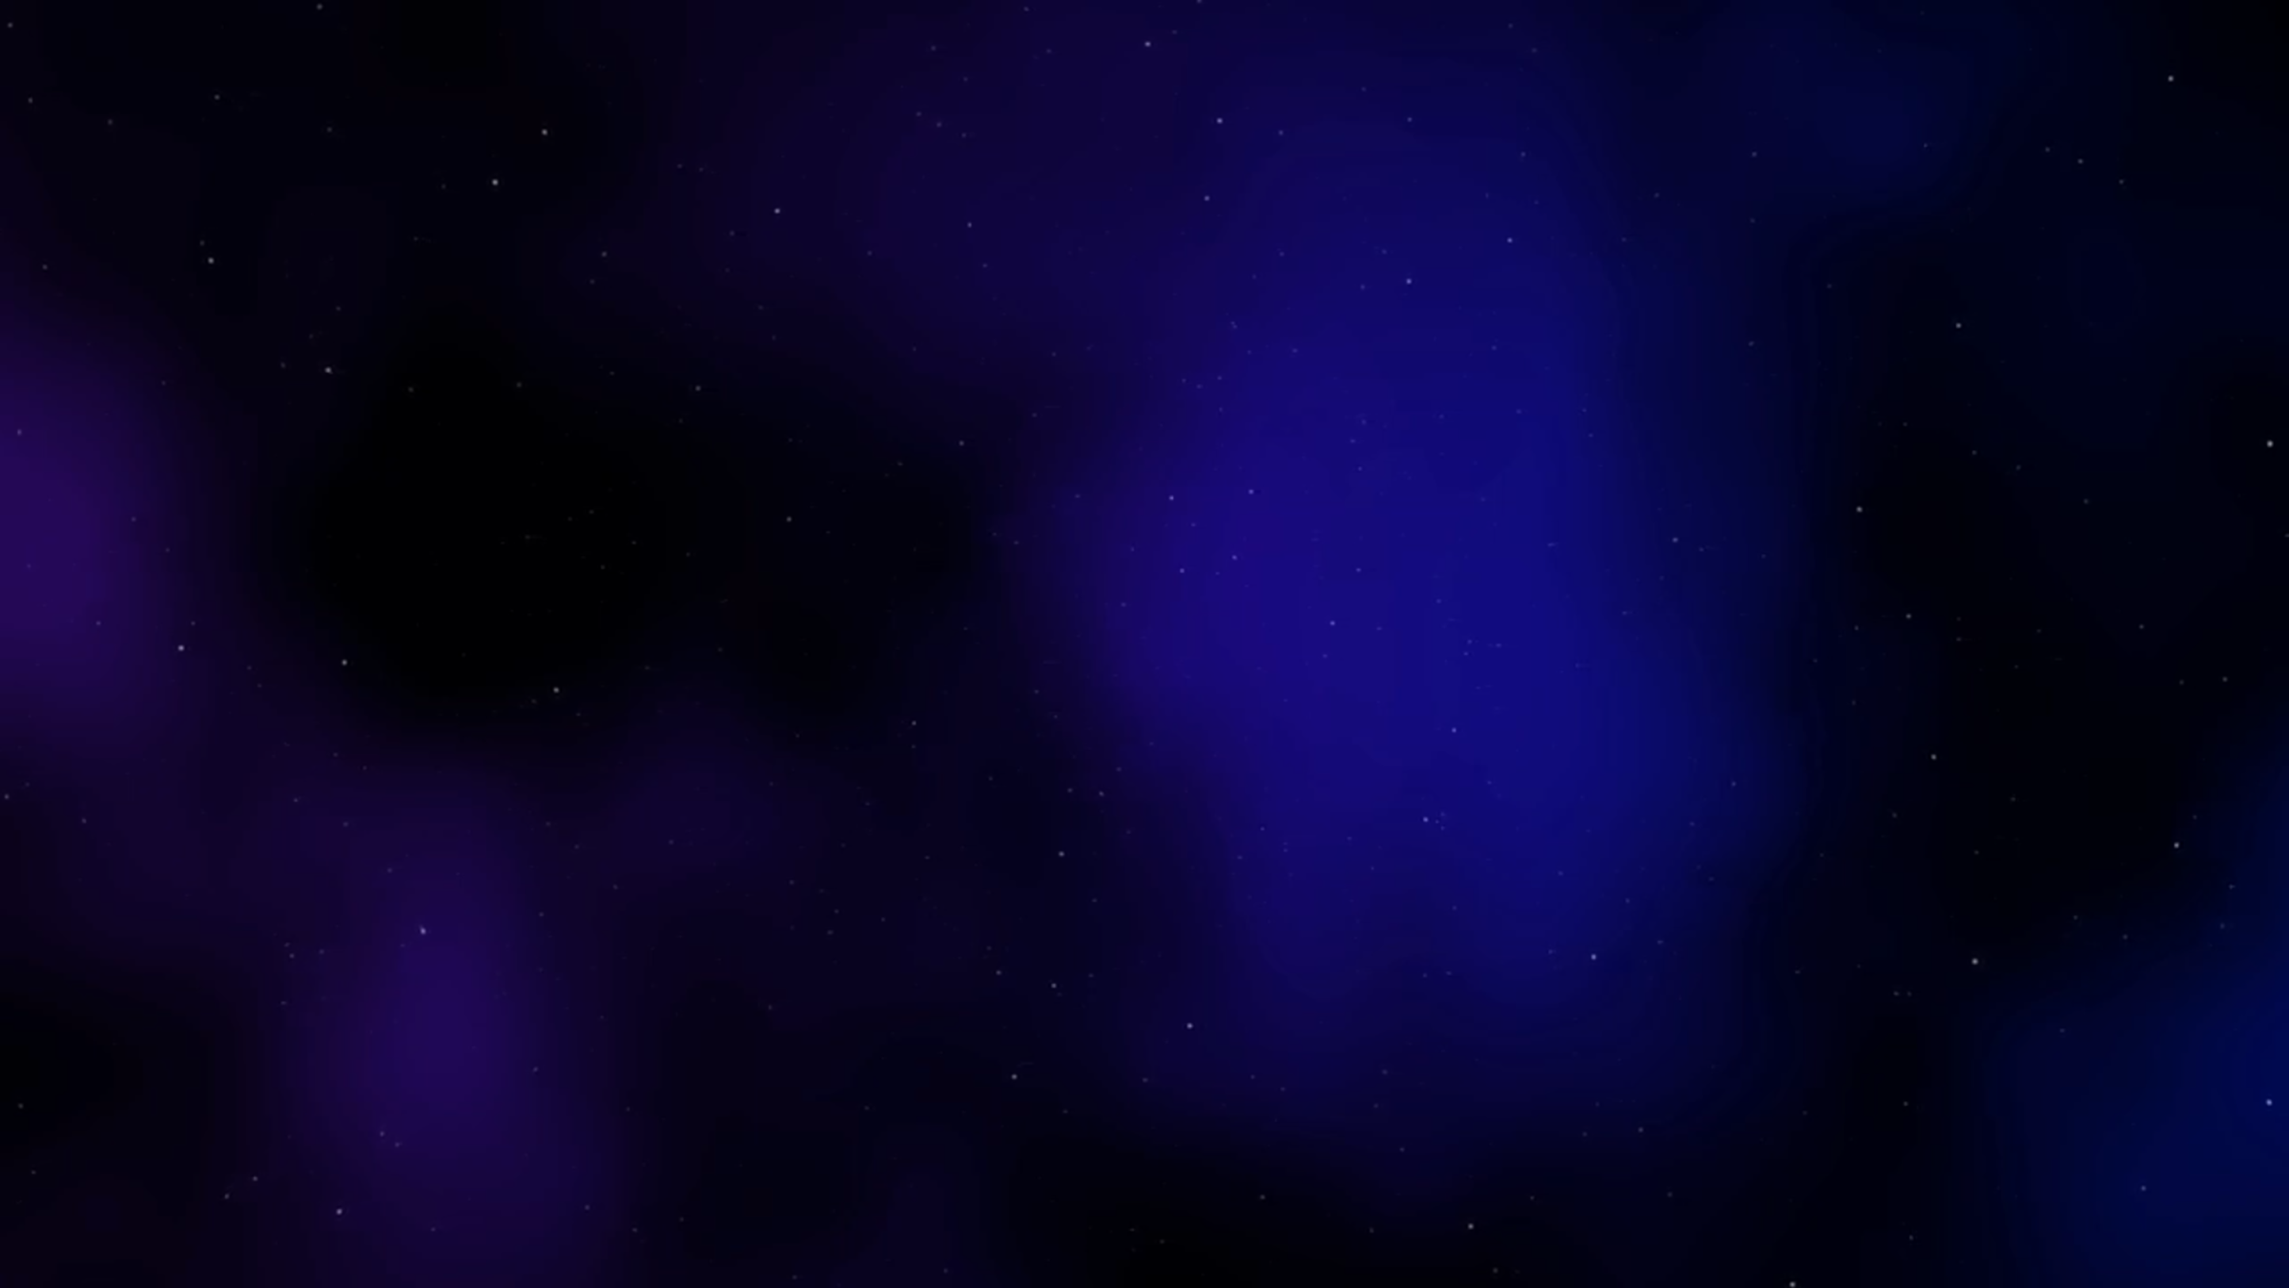
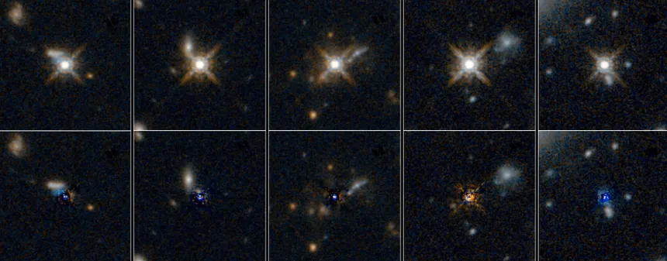
The mission
while exploring the space we observed cosmic bodies, strange ones...
they look like stars, shine like Galaxies..they must be
QUASARS

Slide 3
Data Acquisition & Structure
Data Source: SDSS DR19 Database
Schema Reference: DR19Q_prop Table
Extraction Query:
SELECT TOP 1000
p.u, p.g, p.r, p.i, p.z,
s.z AS redshift,
s.class
FROM PhotoObj AS p
JOIN SpecObj AS s ON s.bestObjID = p.objID

Slide 4

The Photometric Features (u, g, r, i, z)
Mapping the Radiation Signature
The Five Bands: These measure the intensity of light from ultraviolet (u) to infrared (z).
A "Color Fingerprint": Comparing these bands creates a unique signature for every object.
Why it Matters: It allows the model to easily distinguish between the glow of a normal Star (powered by nuclear fusion) and a Quasar (powered by a supermassive black hole).

Slide 5

The Most important Feature
They move fast
Redshift
Quasars are billions of light-years away, yet look like nearby stars to standard telescopes. Redshift (z) is our only clue to their true distance.
Redshift measures how light is stretched as objects move away. In our model, this feature emerged as the absolute separator between galactic neighbors and cosmic titans.

Slide 6
Challenges in the Data
Cleaning the Noise
Hidden Missing Data: We identified and filtered out standard astronomical placeholder values (like -9999, -10000) that would have skewed the model's math.
Extreme Class Imbalance: Quasars made up less than 10% of the dataset, meaning standard models would naturally ignore them to artificially inflate their overall accuracy.

Slide 7

Overcoming the Imbalance
Baseline Testing: We evaluated Logistic Regression and Random Forest classifiers.
Algorithmic Weighting: We applied class_weight='balanced' to heavily penalize the models for missing the rare Quasars.

Slide 8
Results & Conclusion
Final Performance
Accuracy: The Random Forest model achieved a 96% overall accuracy, predicting Galaxies and Stars almost perfectly.
Improving Recall: By actively managing the class imbalance, we forced the model to successfully identify the rare Quasars rather than just guessing "Galaxy" every time.
Conclusion: By feeding the algorithm just six specific physical features (5 light bands + redshift), we successfully built a pipeline that classifies deep space objects with high precision, without needing to process heavy, complex telescope images.

Slide 9
